Slide 1
Cybersecurity Overview
Alonzo Perry
Navigating fundamentals, learning, and collaborative growth.

Slide 2
Introduction
I’ve been in the industry for over 2 decades in various roles.
Tech support, Network admin, Sys-admin, Web development, Infrastructure lead, DevOps engineer, Research & Development, Management, Compliance technical reviewer, Security engineering.
Mostly for public sector but a fair amount of private sector roles as well.
Currently working as a Principal Security Engineer for a large cloud service provider and software company.
Spent over a decade in the Air National Guard.
Aircraft Avionics - Communications and Navigations systems for C-130s.
Several deployments to various locations around the world.

Slide 3
“Be like water making its way through cracks. Do not be assertive, but adjust to the object, and you shall find a way around or through it. If nothing within you stays rigid, outward things will disclose themselves.
Empty your mind, be formless. Shapeless, like water. If you put water into a cup, it becomes the cup. You put water into a bottle and it becomes the bottle. You put it in a teapot, it becomes the teapot. Now, water can flow or it can crash. Be water, my friend.”
— Bruce Lee

Slide 4
Topics covered
Foundations
Security Fundamentals
Roles
Frameworks
Compliance
AI/Machine Learning
Continuous Learning
Q&A

Slide 5
Common Acronyms
CWE: Common Weakness Enumeration
CVE: Common Vulnerabilities and Exposures
NVD: National Vulnerability Database IOC: Indicators of Compromise APT: Advanced Persistent Threat TTP: Tactics, Techniques & Procedures
SOC: Security Operations Center
PII: Personal Identifiable Information
IoT: Internet of Things

Slide 6
Foundations
01
Suggestions for helpful prerequisites

Slide 7
Tips - Securing your world - Passwords
Use Strong Passwords
All passwords should be:
Long: At least 16 characters
Unique: Never reuse passwords
Random: Use a random string of mixed-case letters, numbers and symbols, like: Yuc8$RikA34%ZoPPao98t
Keep your passwords safe by using a password manager!
https://www.cisa.gov/sites/default/files/2024-09/Cybersecurity-Awareness-Month-2024-Posters.pdf

Slide 8
Tips - Securing your world - MFA
Turn on Multi Factor Authentication
Multifactor authentication provides an extra layer of security on your accounts and may include a biometric login or entering a code sent to your phone or email.
Note: When possible, download “bypass/backup” codes. This can be useful when all other authentication methods have been exhausted. Consider keeping them offline in written or printed format.
https://www.cisa.gov/sites/default/files/2024-09/Cybersecurity-Awareness-Month-2024-Posters.pdf

Slide 9
Tips - Securing your world - Updates
Update Software
Updating software and devices is the easiest way to stay protected from security threats. Perform updates as soon as they become available or set automatic updates.
Note: This includes mobile and IOT devices as well. Common, smart household devices and network gear (routers, mesh gear) could open your home up to unwanted intruders.
https://www.cisa.gov/sites/default/files/2024-09/Cybersecurity-Awareness-Month-2024-Posters.pdf

Slide 10
Tips - Securing your world - Phishing
Recognize and Report Phishing
Keep an eye out for phishing and other scam attempts in your emails, texts, direct messages or phone calls. Always verify the sender before clicking links or downloading attachments. If you spot a scam, report it!
Note: This also applies to Deepfakes. AI generated video, audio, & images can also be used manipulate a target.
https://www.cisa.gov/sites/default/files/2024-09/Cybersecurity-Awareness-Month-2024-Posters.pdf

Slide 11
Foundational items
Operating systems
Linux, Windows, MacOS, Unix variants, mobile
Common Linux flavors: Redhat/Centos, Oracle Linux, Debian/Ubuntu, Kali
Common BSD flavors: OpenBSD, FreeBSD, NetBSD
Hardware basics (CPU, memory, storage, I/O cards (USB), network cards)
Networking
DNS
Applications and services
Web apps, databases, system services, email, SSH, VPN, NTP

Slide 12
Foundational items - cont’d.
IoT (Internet of Things)
Virtualization
Containers (Docker, Kubernetes etc..)
Cloud infrastructure (services and connectivity)
Coding
Bash, Python, Powershell, C++, Java etc..
IDE (Integrated development environment)
CI/CD: Continuous Integration/Continuous Delivery or Deployment
GIT (Source control)
Local and remote resources like GitHub
Bitbucket
Logging

Slide 13
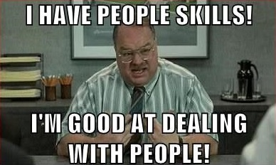
Foundational items - cont’d.
Communications (oral/written)
Other soft skills
Networking with people
Mentors/Mentees
Public speaking (Toastmasters)
Collaboration & team oriented approaches
Conflict management
Flexibility and adaptability
Time management
Anxiety management
Imposter syndrome
Positive attitude

Slide 14
Security Fundamentals
02
An overview of key areas of interest

Slide 15
Security items
Firewalls and proxies
Intrusion detection, Intrusion prevention
Malware detection
EDR (Endpoint detection and response)
XDR (Extended detection and response)
Access controls
LDAP/AD
Passwords, MFA
Cryptography
PKI
TLS/SSL
Hashing (files etc)
Wi-Fi (WPA2, WPA3)
VPNs, SSH, SCP
Nmap

Slide 16
Security items - cont’d
Configuration management
Chef, Puppet, Ansible
Microsoft GPO (Group Policy)
Microsoft Intune
Patching
OS, Applications, Firmware
Backups
Documentation
SOPs (Standard operating procedures)
Runbooks
Vendor documentation
Local “help” documentation

Slide 17
Security items - cont’d
XSOAR (Extended Security Orchestration, Automation, and Response)
UBA/RBA (User/Risk based analytics)
Zero Trust security
Insider Threat training
Employee training (Social Engineering, Phishing, standard annual security training)
SIEM (Security Information and Event Management)
Log analysis, alerting, reporting & auditing, threat hunting

Slide 18
SIEM (Security Information and Event Management)
Robin
Mark
Lisa
SIEM
SOC
File Server
Web Server
Mail Server

Slide 19
Roles
03
One team, one fight

Slide 20
Roles: Red vs Blue (& Purple)
Blue Team
Red Team
SOC (Security Operations Center)
Threat Hunting
Incident Response
Forensics
Threat Intelligence
Security Engineering
Auditing
Pentesting
Adversary Emulation
Security Research
Security Assessments
Auditing

Slide 21
Roles: Incident Response
Coordinates the response effort between stakeholders
Gathers evidence
Often works directly with other Blue team members for threat hunts
Incident remediation
Documentation and AARs (after action reports)
Conducts periodic TTX with other shareholders (tabletop exercises)

Slide 22
Frameworks
04
Guidelines and best practices

Slide 23
Frameworks & Best Practices
MITRE ATT&CK
MITRE ATLAS
NIST 800.53 rev 5
OWASP Top Ten
NIST Risk Management Framework
NIST NICE Framework
NIST AI RMF (Risk Management Framework)
NIST Cybersecurity Framework
MITRE CWE

Slide 24
OWASP Top Ten
https://owasp.org/www-project-top-ten/
A01:2021-Broken Access Control
A02:2021-Cryptographic Failures
A03:2021-Injection
A04:2021-Insecure Design
A05:2021-Security Misconfiguration
A06:2021-Vulnerable and Outdated Components
A07:2021-Identification and Authentication Failures
A08:2021-Software and Data Integrity Failures
A09:2021-Security Logging and Monitoring Failures
A10:2021-Server-Side Request Forgery

Slide 25
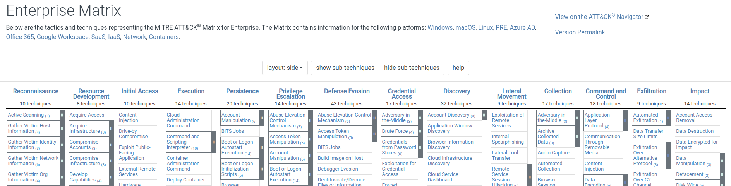
MITRE ATT&CK
https://attack.mitre.org

Slide 26
Cyberattacks
Yahoo - 2013/2014
Notes: Misconfigured database and unauthorized access
Impact: 3 billion user accounts exposed. PII & security questions & passwords
Equifax - July 2017
Notes: Misconfigured database and unauthorized access
Impact: 143 million user’s PII exposed. 200,000 user’s credit cards exposed
SolarWinds - September 2019
Notes: Supply chain attack
Impact: Massive financial loss in some industries. 18,000 customers received a compromised software update

Slide 27

Bob’s Coffee - Cyberattack
Incident: A breach occurred by a group of hackers against coffee. (Thousands of people were forced to drink tea.)
Root Cause: Misconfigured network devices and unauthorized access.
OWASP: A05:2021 - Security Misconfiguration
MITRE ATT&CK: Initial Access: “Exploit Public-Facing Application” (T1190)

Slide 28
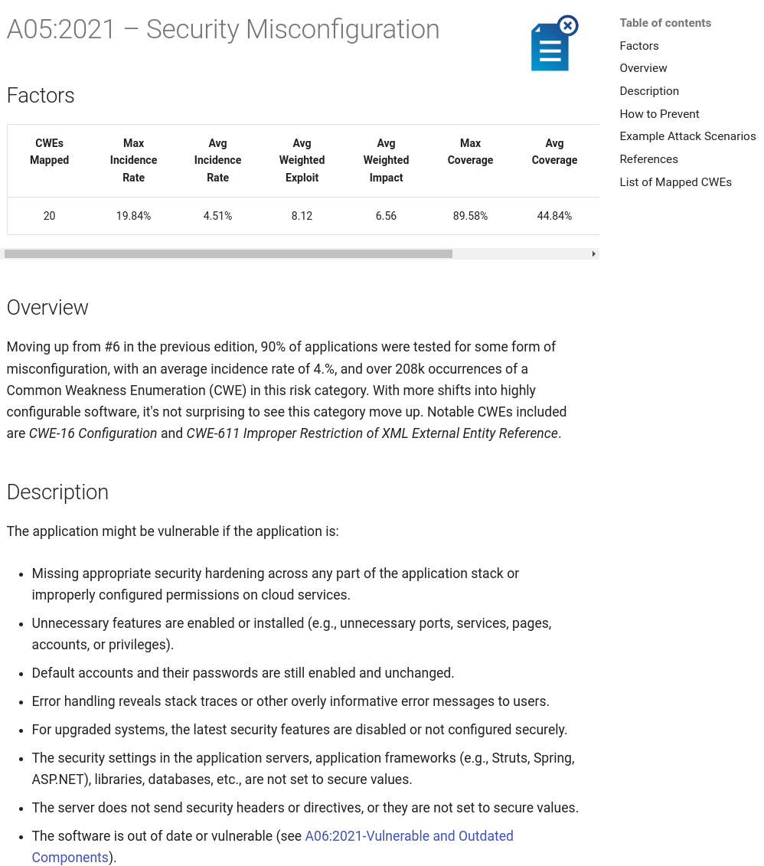
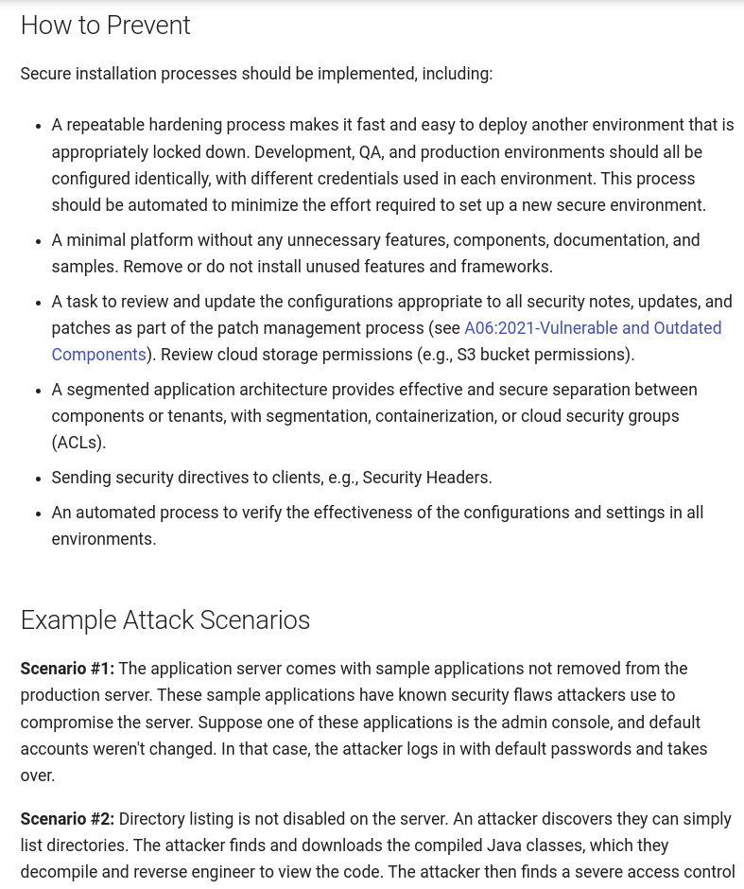
Bob’s Coffee - OWASP

Slide 29
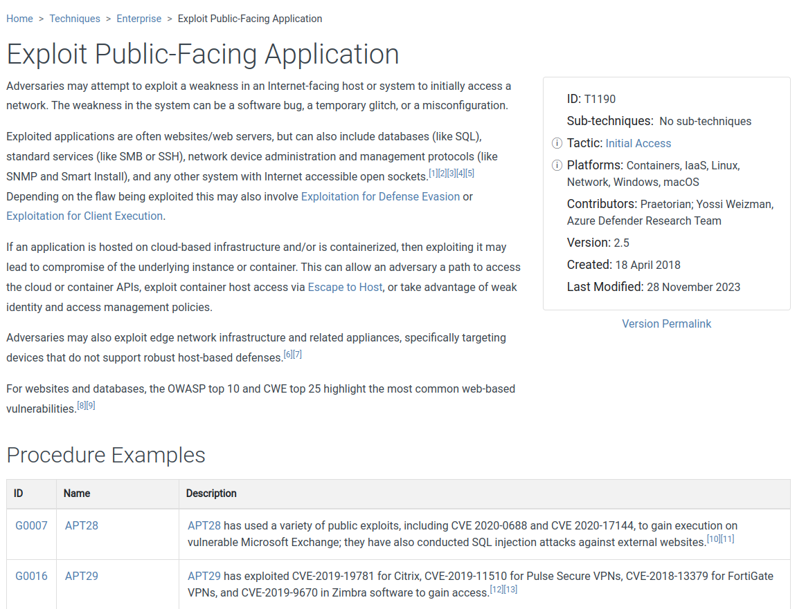
Bob’s Coffee - MITRE ATT&CK

Slide 30
Compliance
05
I know….Just hear me out.

Slide 31
Compliance
NIST SP 800.53
HIPAA (Health Insurance Portability and Accountability Act)
PCI-DSS (Payment Card Industry Data Security Standard)
FedRAMP (Federal Risk and Authorization Management Program)
GDPR (General Data Protection Regulation)
European Union
DISA STIG - Typically associated with the Department of Defense

Slide 32
Compliance - NIST 800.53 rev 4
A total of 20 control families. Some of the notable families include:
AC: Access Control
AU: Audit and Accountability
IA: Identification and Authentication
IR: Incident Response
SC: System and Communications Protection
SI: System and Information Integrity

Slide 33
AI/Machine Learning
06
The robot elephant in the room

Slide 34
Artificial Intelligence/Machine Learning
Note: Output from LLMs (Large Language Models) should always be verified for authenticity
Educational/professional uses
Research
Summarization
Code examples and reference information (grain of salt)
Red team
Malware generation
Phishing campaigns
Deepfakes, fraud, hoaxes
Blue team
Signals intelligence
Detections engineering for anomalies in large datasets
Documentation

Slide 35
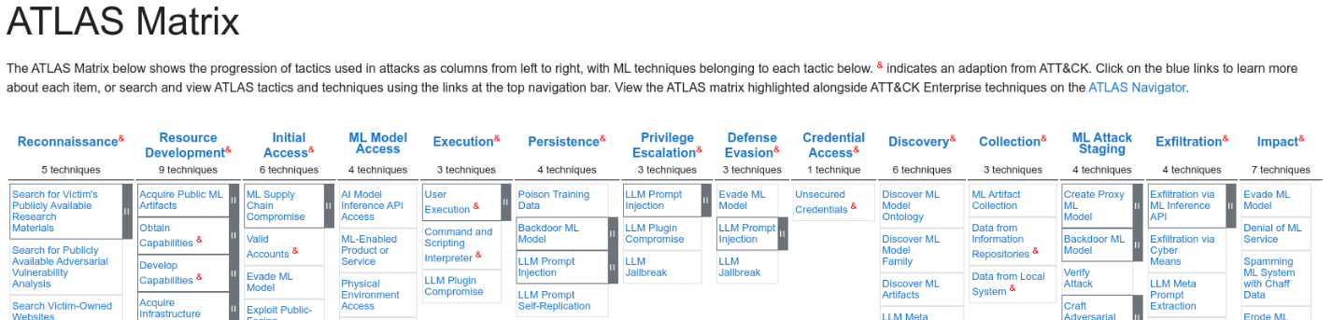
MITRE ATLAS
https://atlas.mitre.org

Slide 36
OWASP Top Ten for LLM Applications (1-5)
Prompt Injection
Training Data Poisoning
Supply Chain Vulnerabilities
Insecure Object Handling
Model Denial of Service
https://genai.owasp.org/resource/llm-top-10-for-llms-v1-1/

Slide 37
Continuous Learning
07
“Continuous improvement is better than delayed perfection”

Slide 38

It never stops…
“Upgrade your grey matter, cause one day it may matter.”
Deltron 3030

Slide 39
Homelabs and other resources
Repurpose old hardware
Put that old laptop to use!
Install VirtualBox, VMWare, or KVM
Doesn’t require any additional costs
Can be used to learn about virtualization, networking, and the cloud
Raspberry Pis
Low powered, inexpensive, & can run Linux
Use cloud-based resources
A bridge to understanding enterprise (large scale) environments
Can be very affordable if managed properly

Slide 40
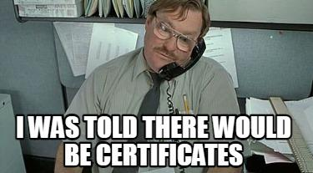

Slide 41
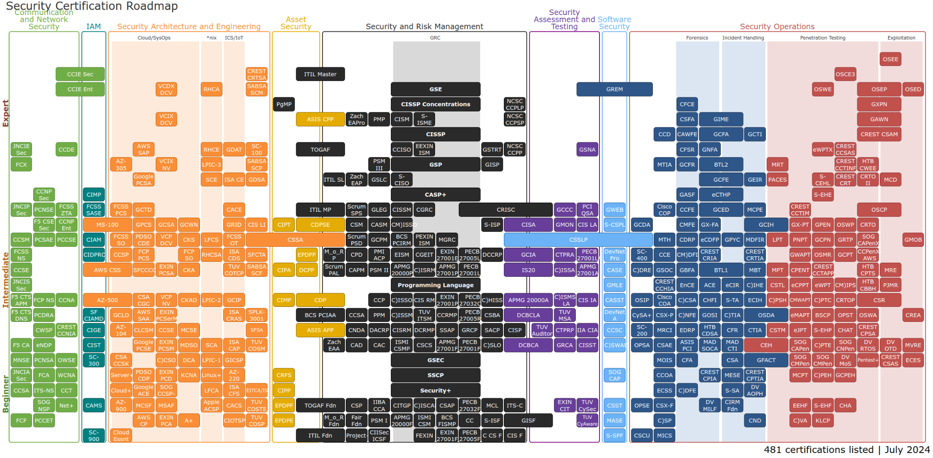
https://pauljerimy.com/security-certification-roadmap/

Slide 42
THANKS!
Do you have any questions?
alonzotech3030@gmail.com
linkedin.com/in/alonzo-perry-782b915
(additional reference information and a copy of this presentation can be found on Github)
https://github.com/alonzoperry/CAM2024

Slide 43
Lab ideas
Set up a virtual machine server (see homelabs slide)
Set up a basic file server (as a bare metal host or VM)
Set up a SIEM (Wazuh, Splunk) and analyze data from other machines on your network
Learn how to create detections and alerts
Set up “Security Onion” (Linux based infosec distro with several great tools out of the box including a SIEM)
Create a backup server
Red Team
Install Kali Linux and learn about Red Team capabilities.
Research password cracking with hashcat and “Jack the Ripper”
Install “nmap” (network mapper/scanner)
Set up a Malware analysis lab
(All of the above could be virtual machines on your server)

